Slide 1
Polytechnic University of Tirana Faculty of Information Technology Computer Engineering Department
a multithreaded search engine And testing of multithreaded code in java
Blandi Alcani

Slide 2
Overview of the presentation
Specifications
Design
Multithreading in Java
Concurrent Data Structures in Java
Text Extracting Libraries
Implementation and screenshots
Testing of the Multithreaded environment in Java

Slide 3
1. Specifications
Index text documents located in the hard drive or the local network.
Should be able to index files of different types including Microsoft Word, PDF, plain text, rich text format etc.
The index is to be held in a data structure with a high performance such as a hash table.
The indexing of the files should be made in a multithreaded environment.

Slide 4
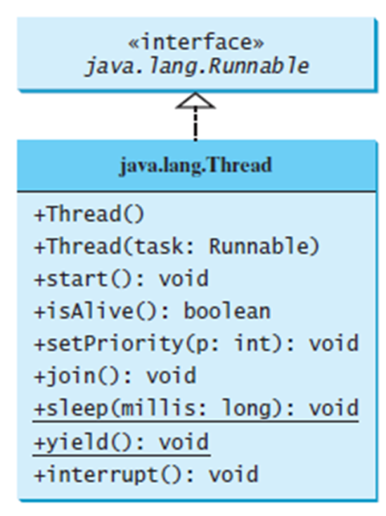
2.1 Multithreading in Java – an overview
A thread in Java is an object that implements the Runnable interface.
Runnable defines the method run() – where the code of the thread is written.
A thread class can be created by
extending the Thread class, which
implements the Runnable interface
and can invoke a thread by using
Thread.start()

Slide 5
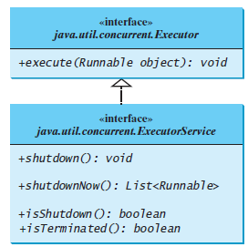
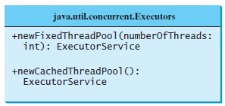
2.1 Management of threads in Java
Starting a thread manually can be difficult.
For each thread => Thread Object => Too much overhead.
An Executor object can start
many threads.
An ExecutorService object can
terminate many threads.
Thread Pools offer recycling of
thread objects, thus avoiding thread
creation overhead.

Slide 6
2.2 Data structures in Java – Collections Framework
“Container” of Objects.
Easy data manipulation (search, insert, delete)
Can be used with iterator objects.
Two main divisions: Collections and Maps
Key => Value
Words in a document => Document name/location, line etc.
Concurrent Maps – Multithreading support

Slide 7
2.2 ConcurrentHashMap
It is thread safe without synchronizing the whole map.
Reads can happen very fast while write is done with a lock.
The locking is at a much finer granularity at a hashmap bucket level.
ConcurrentHashMap uses multitude of locks.

Slide 8
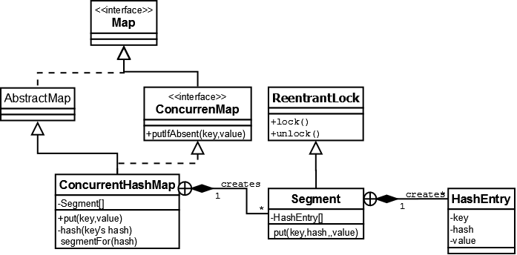
2.2 ConcurrentHashMap

Slide 9
2.3 Text Extracting Libraries
Apache Open Source Libraries
Implemented in 100% Java, good performance.
PDFBox – Apache Library for PDF documents manipulation and extraction of text.
Apache POI - Apache Library for Microsoft documents manipulation and extraction of text.

Slide 10
3. Implementation and Screenshots
User friendly, simple menu based GUI
Separation of user interface and functionality.
Searching with binary operands
Index class is serializable, object => file and vice-versa.
3 classes
Index entry class
Index class
User interface class

Slide 11
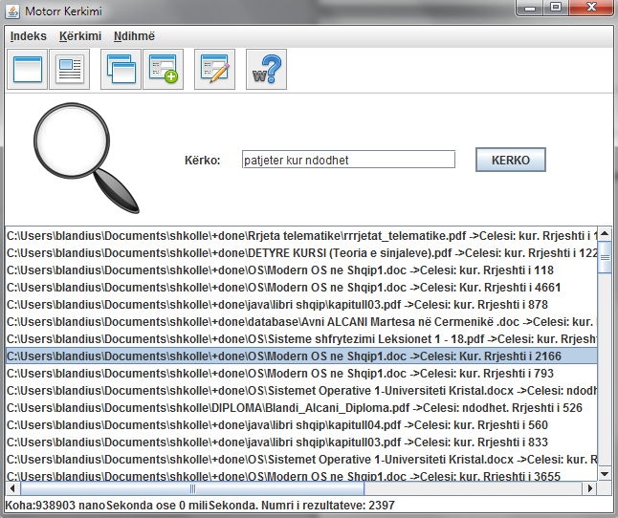
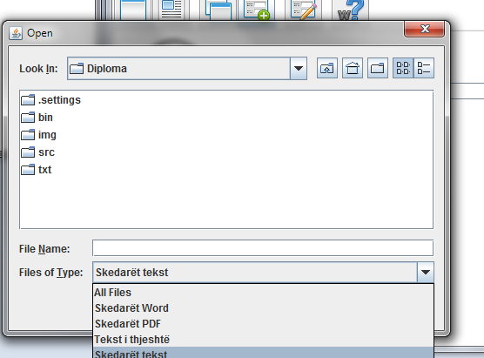
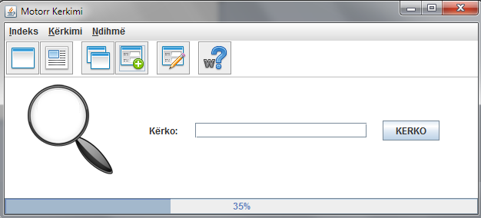
3. Implementation and Screenshots

Slide 12
4. Testing in the multithreaded environment
Testing multithreaded code can be difficult and challenging:
Concurrency introduces non-determinism – Multiple executions of the same test may have different interleaving (different execution order for threads)
Bugs are very hard to reproduce and debug
3 main approaches to test multithreaded code:
JUnit, thread management left to the application.
JUnit, thread management done from JUnit.
Third party libraries for JUnit, specialized in concurrent code testing.

Slide 13
4. Testing in the multithreaded environment
JUnit, thread management left to the application.
Pros:
No modification of the original software needed.
Cons:
Less control of thread management.
Least effective. No significant multithread related bugs are caught.

Slide 14
4. Testing in the multithreaded environment
JUnit, thread management done from JUnit.
Pros:
More control of thread management – more scenarios covered, more bugs detected.
Cons:
Requires modification of original application before and after the tests.

Slide 15
4. Testing in the multithreaded environment
Third party libraries for Junit, specialized in concurrent code testing.
For example: ConTest by IBM, jMock, GroboUtils etc.
Pros:
Cause synchronization problems to more likely surface in testing
Support the traditional test coverage models (e.g. branch coverage and method coverage) as well as advanced synchronization coverage models
Support partial replay, increasing likelihood that a program scenario which gave rise to a specific synchronization problem will recur
Produces a lot of useful debugging information
More bugs detected
Best option
Cons:
Learn the API
Usually requires licence

Slide 16
Thank you!
References
D. Liang, Introduction to Java Programming (2010)
B. Goetz, Java Concurrency in Practice (2006)
Apache POI project, poi.apache.org
ConTest Project, https://www.research.ibm.com/haifa/projects/verification/contest/

